Slide 1




Jenson USA
Sales Insights
Exploring Performance, Sales,
and Insights
1
Mandeep Kumar
Mandeep Kumar

Slide 2
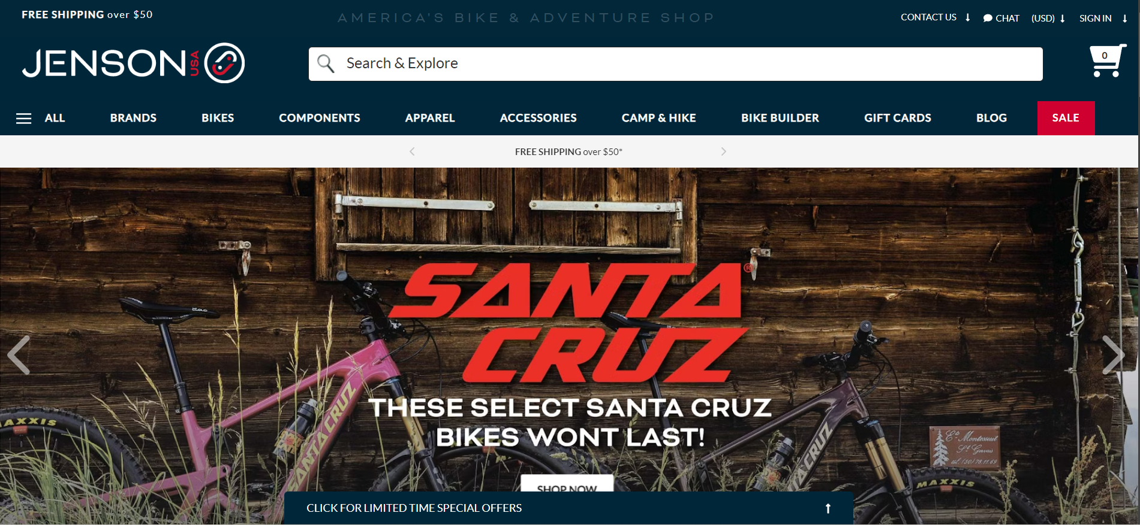
About Company
Founded in 1994 and headquartered in Riverside, California, Jenson USA is a premier retailer in the cycling industry. Offering over 30,000 products, including bikes, parts, and accessories, the company caters to cycling enthusiasts worldwide through its online store and retail locations.
Jenson USA is committed to customer satisfaction, sustainability, and teamwork, earning recognition in the Internet Retailer Top 500 and as a Top Workplace in the Inland Empire. With a passion for cycling and over 25 years of industry leadership, Jenson USA continues to set the standard for innovation and service in the cycling community.
2
Mandeep Kumar

Slide 3
Objective
Use SQL queries to analyze customer, staff, inventory, and store data.
Key Insights:
Customer spending behavior.
Staff performance.
Inventory and product trends.
Store-level operational metrics.
Dataset Link : Click here!
3
Mandeep Kumar

Slide 4
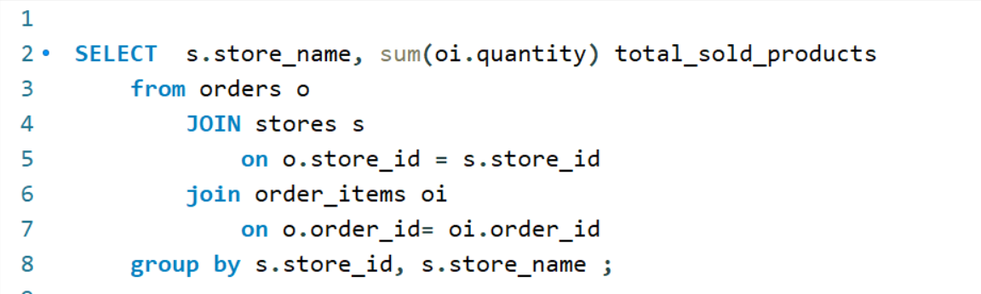
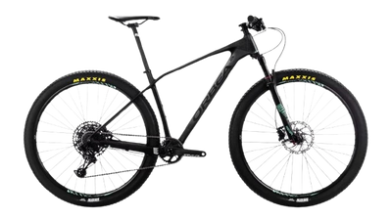
Find the total number of products sold by each store along with the store name.
4
Mandeep Kumar

Slide 5
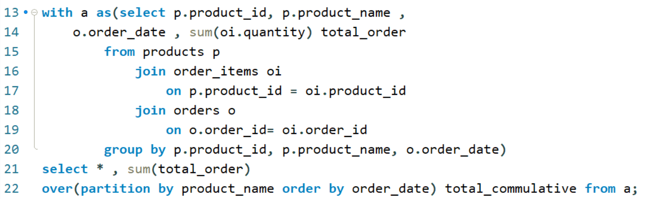
Calculate the cumulative sum of quantities sold for each product over time..
5
Mandeep Kumar

Slide 6
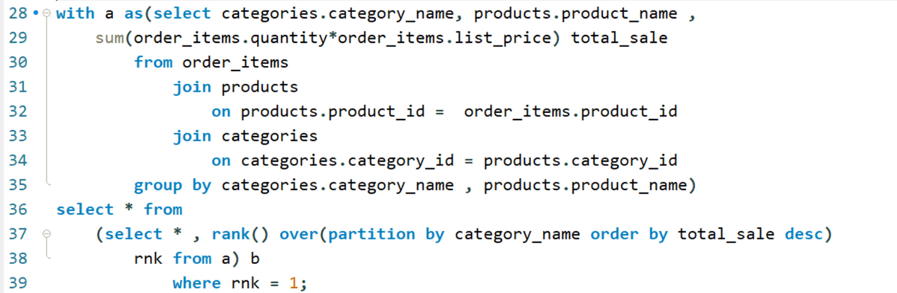
Find the product with the highest total sales (quantity * price) for each category.
6
Mandeep Kumar

Slide 7
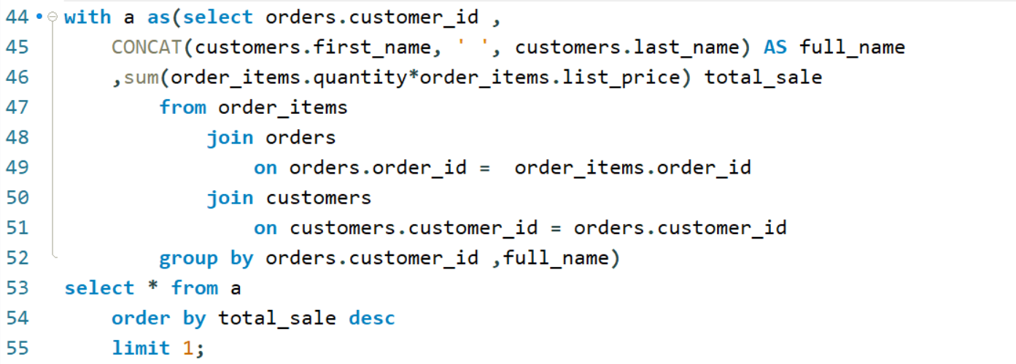
Find the customer who spent the most money on orders
7
Mandeep Kumar

Slide 8
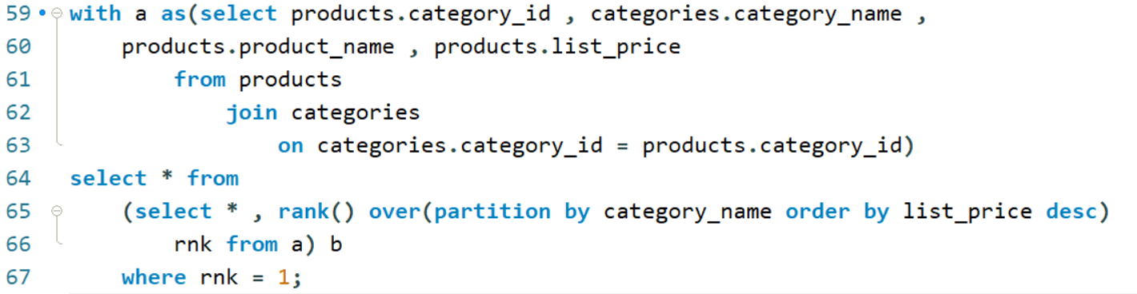
Find the highest-priced product for each category name.
8
Mandeep Kumar

Slide 9
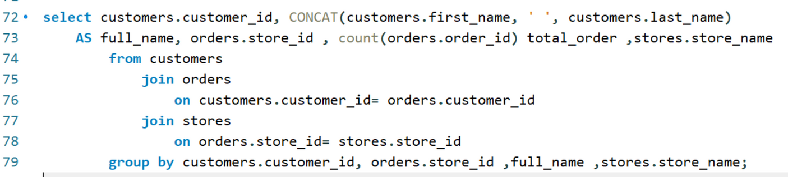
Find the total number of orders placed by each customer per store
9
Mandeep Kumar

Slide 10
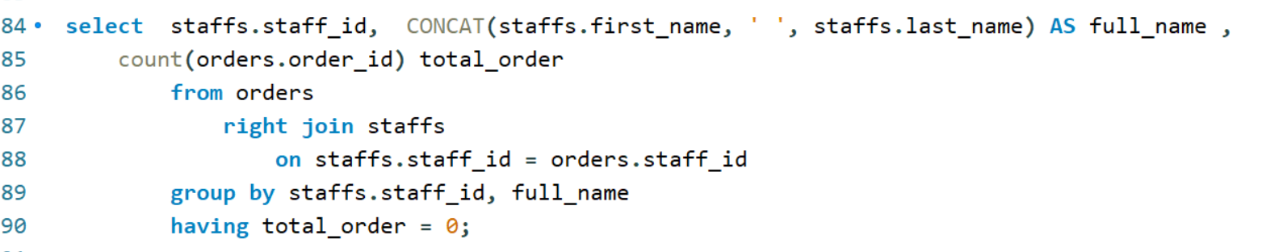
Find the names of staff members who have not made any sales
10
Mandeep Kumar

Slide 11
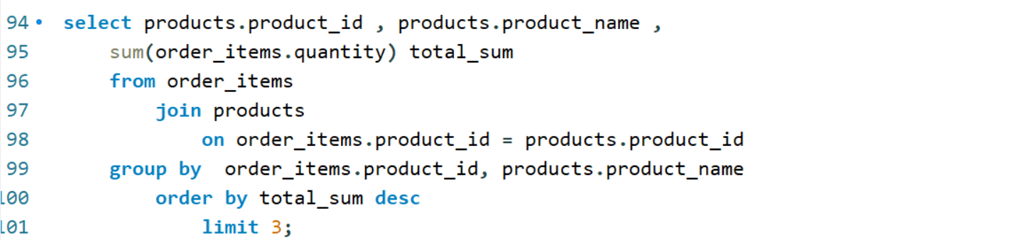
Find the top 3 most sold products in terms of quantity.
11
Mandeep Kumar

Slide 12
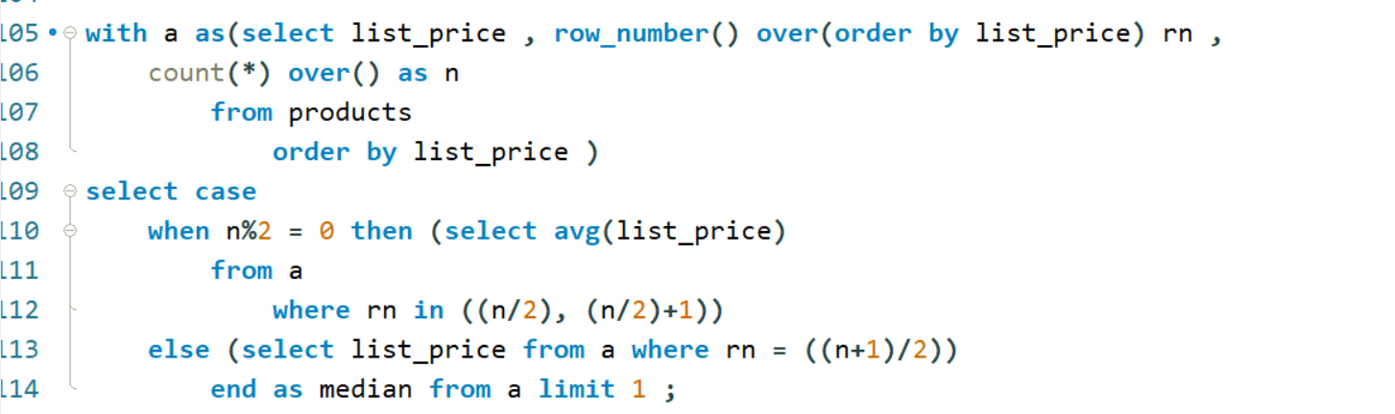
Find the median value of the price list.
12
Mandeep Kumar

Slide 13
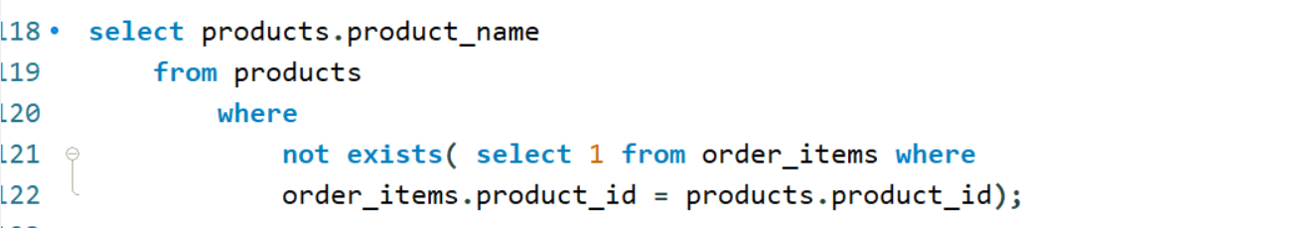
List all products that have never been ordered.(use Exists)
13
Mandeep Kumar

Slide 14
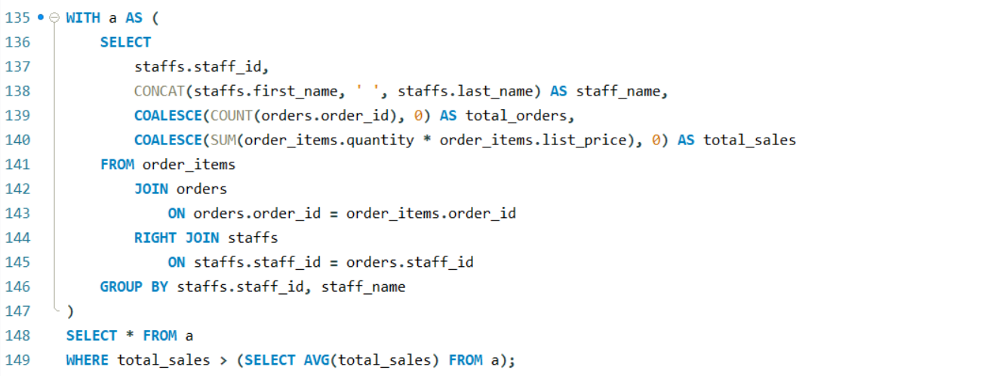

List the names of staff members who have made more sales than the average number
of sales by all staff members.
14
Mandeep Kumar

Slide 15
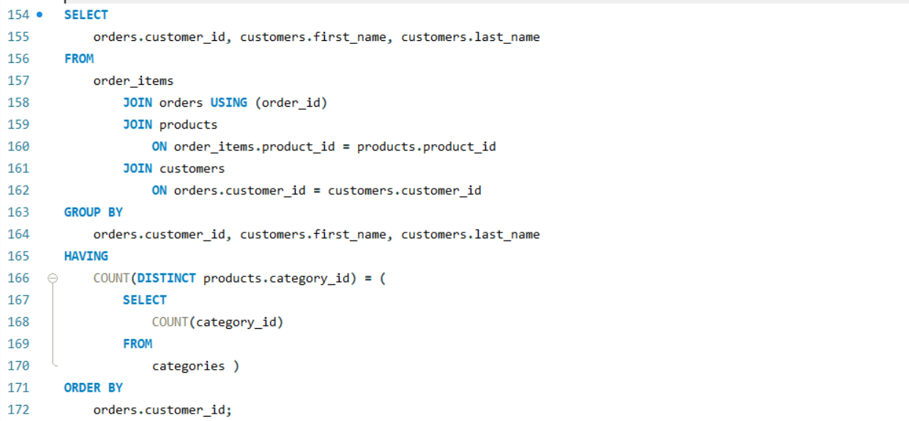
Identify the customers who have ordered all types of products (i.e., from every category)
15
Mandeep Kumar

Slide 16

Challenges & Learnings
Challenges Faced:
Working with large datasets.
Complex queries for specific insights
(e.g., cumulative sums, median calculations).
Learnings:
Enhanced SQL proficiency.
Better understanding of data analysis for business decision-making.
16
Mandeep Kumar

Slide 17

Conclusion & Future Scope
Summary:
Insights generated using SQL are critical for informed business decisions.
Future Scope:
Use advanced analytics (e.g., machine learning) for predictive insights.
Implement dashboards for real-time analysis.
17
Mandeep Kumar

Slide 18

I appreciate your time and interest in this project.
Please feel free to reach out for any questions or further discussions.
Thank YOU
18
Mandeep Kumar

